Slide 1
Final Project Presentation
Orly Olbum
Monday, April 18, 2022
PS 2707

Slide 2
Project Outline
Use UDS paper (unsupervised application day) as a jumping off point to further explore ideal points
Gain additional experience with plotting and interpreting model output
Apply unsupervised learning to client work at my job

Slide 3
Ideal Point Plot
The plot here is of the ideal points from the emIRT model for a few countries (I also have a plot of all countries, but it is difficult to see)
The red point is the average of the ideal points for each country
I also made a plot of all of the countries, but it is difficult to see
I am stuck on figuring out how to order them – ideally, it’s by the average, either ascending or descending, but stuck on coding this

Slide 4
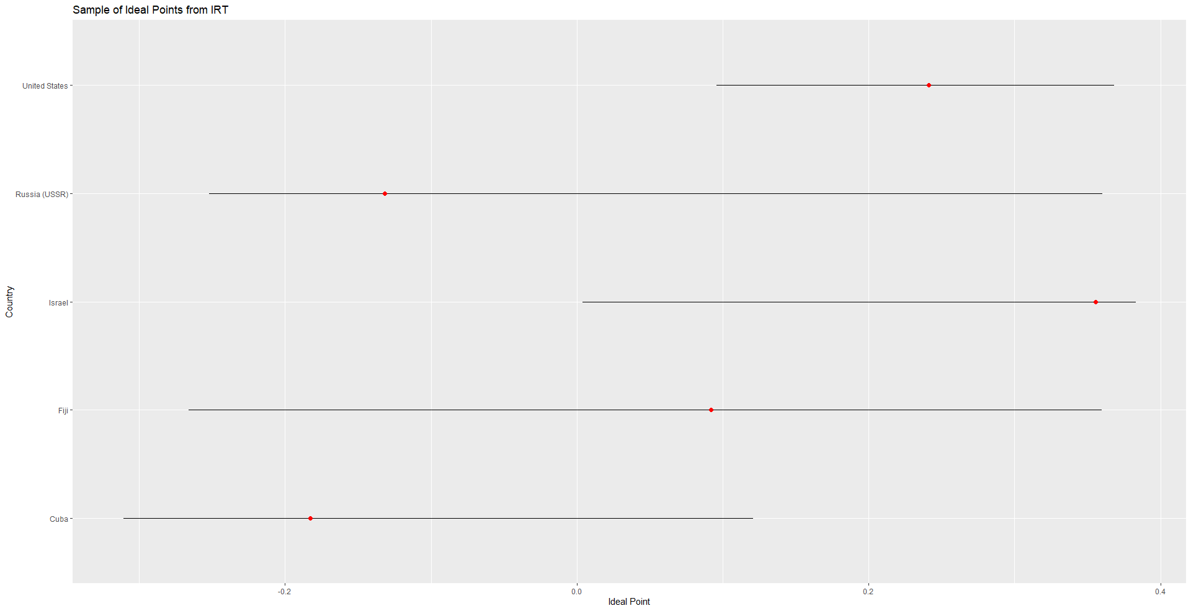

Slide 5
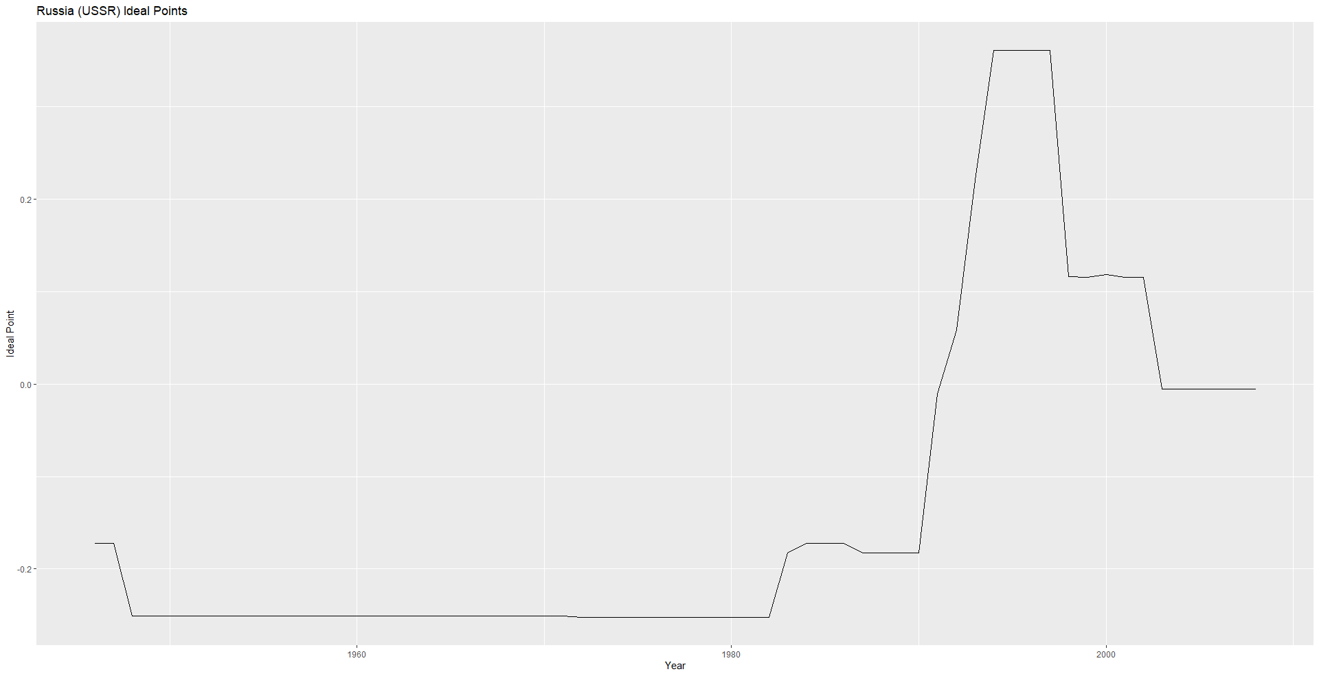
I plotted, for a few countries, the ideal points over time from the model
Using these to show the generalization of the measures of democracy, and accounting for the years where not all of the measures have data for some countries

Slide 6
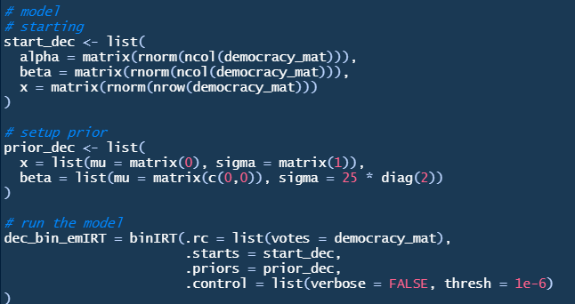
Uncertainty
The next thing to plot would be the ideal points for each country along with uncertainty bars
I am not sure how to access the information needed for this from the model
I’ve done it for MCMC but not for emIRT

